Slide 1
Spark training Spark, Python, PySpark
Turkey, Churn prediction project
Stéphane Collot
Istanbul• 11 November 2015
Notes:
Library called Graph EXE

Slide 2
About me
From south of France
Please interrupt me and ask question
Studies
Ecole des Mines, France: Master of Science in Computer Science
Georgia Tech, USA Atlanta: Master of Science in Big data and machine learning
Good experience in Spark 1.2 with Scala
I joined International Advance Analytics team 4 months ago
50% Data Engineer
50% Data Scientist in Churn prediction project

Slide 3
Goal of the training
Understanding the 3 main ideas of Spark
Overcome ‘barriers to entry’, how to search for help
Familiarize with the tools and the environment (understanding them and installing them)
Find issues with the environment
Defining good practices and way of working for the Churn Project
Practice & struggle together

Slide 4
Agenda
Introduction to Python 45 minutes
Reminder of Git 15 minutes
Introduction to Spark 40 minutes
RDD, Operations
Spark SQL and Hive 30 minutes
Spark features construction 45 minutes
Spark MLlib 45 minutes
Total 220 min / 4h30 38 slides
Notes:
45 + 15 + 40 +30 +45 + 45

Slide 5

Introduction to Python

Slide 6
Python features – Why Python is GREAT ?!
Interpreted
You need to install Python
Doesn’t need compilation
Multi-platform
Object Oriented
Strongly typed and Dynamically typed
>> a = ‘test’
>> type(a)
Multi purpose (Web, GUI, Scripting, Machine learning)
Fast and flexible (Python Shell)

Slide 7
Python versions
2 main versions Python 2 and Python 3
Most used and recommended version is 2.7
Spark 1.3.1 works with Python 2.6 or higher (but not Python 3)
Anaconda is a Python distribution that contains everything you need (packages)!
Timeline
1994 – Python 1.0
2000 – Python 2.0
2008 – Python 3.0
Adoption to 3.0 takes time
No backward compatibility
print “blabla” 2.x
print(“blabla”) 3.x
The tool called ‘2to3’ can convert most of the project from 2 to 3.
Notes:
Python 3 is supported in Spark 1.5
Here we will use Python 2.7

Slide 8
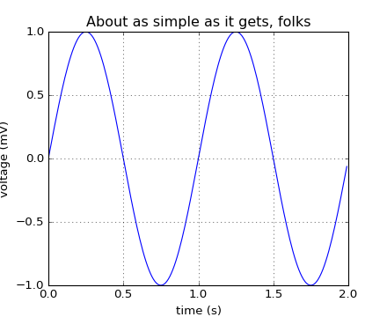
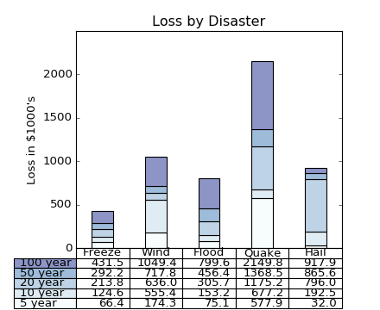
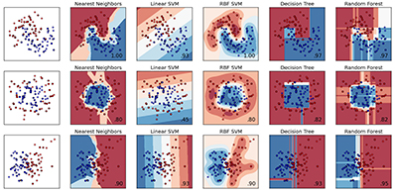
Python packages
A lot of packages !
They are listed in PyPI - the Python Package Index https://pypi.python.org/pypi
Behind a proxy you can use Bandersnatch for mirroring
Famous one:
Numpy: maths, matrices. It has some C dependencies and it is required by PySpark
Matplotlib: graphs, charts, plots
Panda: data structures and data analysis
IPython Notebook (Jupyter): enhanced Interactive Console
SciPy: an ecosystem of all the packages above
scikit-learn: machine learning, data mining/analysis
Very easy to install with pip install <package name>
Anaconda is a Python distribution that contains all of them!
Notes:
Sci(ence) kit learn

Slide 9
Python syntax
Content of test.py
#!/usr/bin/env python
print "Hello World!"
<- This line define for Linux system how execute test.py
$ chmod +x test.py
$ ./test.py
Hello World!
But you can also simply execute with:
$ python test.py
And you can just run Python shell:
$ python
Python 2.6.6 (r266:84292, May 22 2015, 08:34:51)
[GCC 4.4.7 20120313 (Red Hat 4.4.7-15)] on linux2
Type "help", "copyright", "credits" or "license" for more information.
>>>

Slide 10
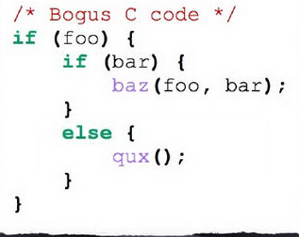
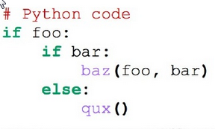
Python syntax – If – Indentation
#!/usr/bin/env python
bl = True
if bl:
print "hey!"
else:
print "nop"
Forget all you know about { } here it is only the indentation that count.
Non-valid indentation will not execute!
Notes:
In C you have the curly bracket and the indentation

Slide 11
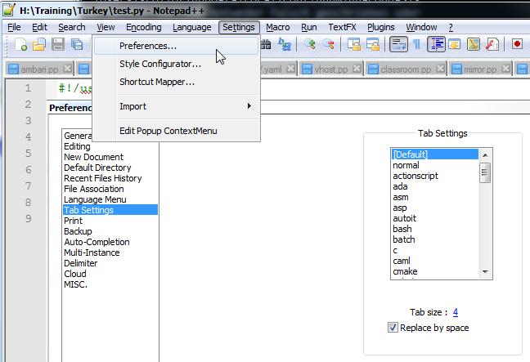
Python syntax – Indentation – Set up your editor !
“Use 4 spaces per indentation level.“
Official Style Guide for Python Code https://www.python.org/dev/peps/pep-0008/#tabs-or-spaces
NEVER mix indentation style, like using Tabs and spaces in the same file

Slide 12
Python syntax - Comment
#!/usr/bin/env python
# One line comment
"""
Several lines block
comment
"""

Slide 13
Python syntax – Types – numbers & lists
# Integers Numbers
year = 2010
year = int("2010")
# Floating Point Numbers
pi = 3.14159265
pi = float("3.14159265")
# Fixed Point Numbers
from decimal import Decimal
price = Decimal("0.02")
optional_data = None
#Lists can be heterogeneous
favotires = []
# Appending with an element
favotires.append(42)
# Extending with another list
favotires.extend([42, "Python", True])
numbers = [1, 2, 3, 4, 5]
len(numbers) # 5
numbers[0] # 1
numbers[1:3] # [2, 3]
numbers[2:] # [3, 4, 5]

Slide 14
Python syntax – Types – Dictionary
Hashmap
person = {}
person['name'] = 'Novewll Strite'
person['favorites'] = [42, 'food']
person['gender'] = 'male‘
print person
{'gender': 'male', 'name': 'Novewll Strite', 'favorites': [42, 'food']}
person.keys()
person.values()
person.items()

Slide 15
Python syntax – Loops
fruits = ['Apple', 'Orange']
for fruit in fruits:
print fruit
#Be careful you cannot modify fruit in the loop.
for x in range(10):
print x
# Not very often used, but equivalent:
x = 0
while x < 10:
print x
x += 1 # There is no x++ operator

Slide 16
Python syntax – Functions
def my_function(param1, param2 = ‘default'):
print "Hey " + param1 + " -> " + param2
my_function('test') # Hey test -> default

Slide 17
Python syntax – Class
class User(object): # Declaration
is_staff = False
def __init__(self, name='Anonymous'):
self.name = name
def is_authorized(self): # Notice that a method contains always “self” as a 1st argument
return self.is_staff # Accessing attributes and methods required “self.”
anonymous = User() # Instantiation
print anonymous.name # Anonymous
print anonymous.is_authorized() # False

Slide 18
Python Exercises
1. Create 2 classes:
Animal
Cat that inherits from Animal
2. List
3. Dictionary

Slide 19

Git Reminder

Slide 20
Git – Simple as Bonjour
Display all the modification of your local folder
in Red: files that are modified, but which will NOT BE in the next commit
in Blue: files that are modified, but which will BE in the next commit
git status
Add a file in the next commit
git add path/to/file.extension
Add all the modified files in the next commit
git add *
Create the commit, it will contain all the modifications of the added files (Blue)
git commit -m "write here the description of your modification"

Slide 21
Git – Simple as Bonjour
Get the latest modification of the repository from Git server
git pull
Please read carefully the output of the command. It will tell you what command to write if there is a conflict.
Send your commit(s) to GitHub
git push
Advice 1: Read what Git tell you, it is telling you most of the time what you should do
Advice 2: NEVER use a graphical interface. On Windows use simply PowerShell

Slide 22
Git – Simple as Bonjour – Sum up
When you start working on the project, and before you do any modification:
git pull
Do you modification, and then write:
git status
git diff
git add * or only specific files
git status
git commit -m “write your comment”
git status
git pull <- read carefully the output of this
git push

Slide 23

Introduction to Spark

Slide 24

What is Hadoop
Hadoop
HDFS, the Hadoop File System: distributed storage, replication for hardware failure
$ hdfs dfs –ls
$ hdfs dfs –put source destination
Yarn, the resource manager
Hadoop MapReduce, implementation of the paradigm
Hive, the SQL engine
...
Spark doesn’t replace Hadoop, it enhances it.
Notes:
The barrier to entry for working with the spark API is minimal

Slide 25
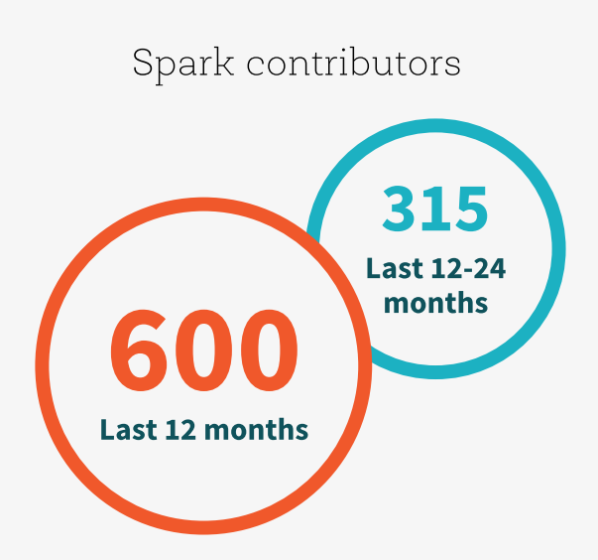
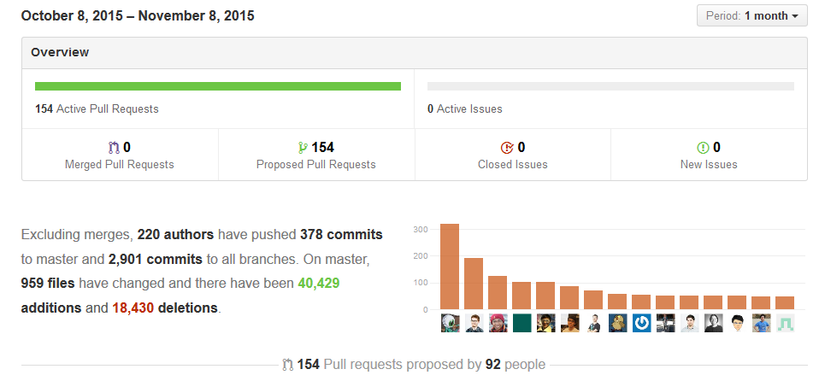



























The Spark Community
Notes:
Hundred of contributor, thousand of commits.
You cannot be a Data Scientist with knowing Spark. It is a very nice thing to have on your CV

Slide 26
What is Spark?
Fast and Expressive Cluster Computing System Compatible with Apache Hadoop
Up to 10× faster on disk, 100× in memory
2-5× less code
Efficient
Usable
General execution graphs
In-memory storage
Rich APIs in Java, Scala, Python
Interactive shell
Notes:
Another implementation of the map/reduce design pattern, that takes advantages as much as possible of the in-memory storage
Generalize the map/reduce framework

Slide 27
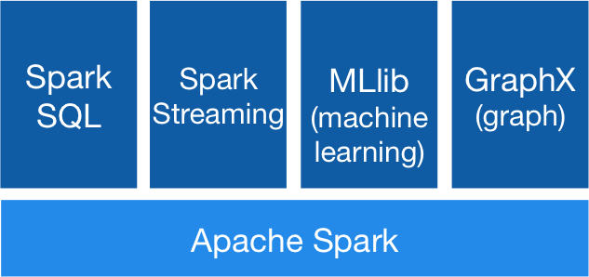
Spark and its modules
They are included:

Slide 28
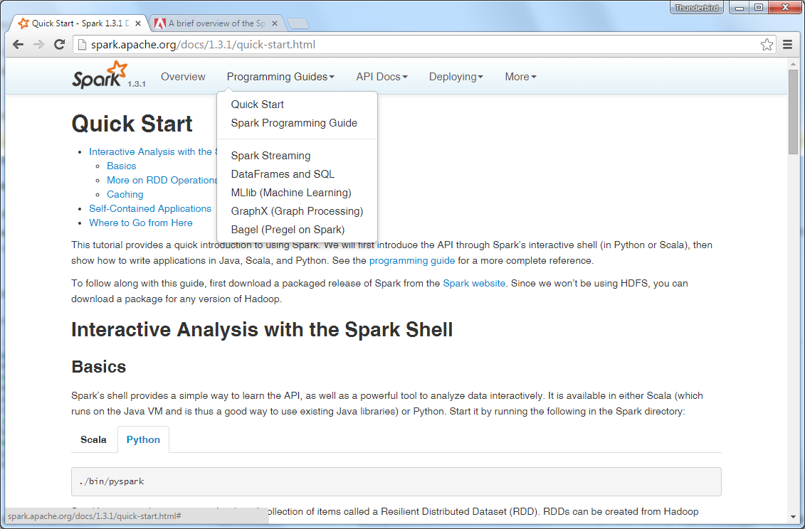
Spark Documentation is GREAT
Check the version
The source code is Scala and very easy to read.
All the functions
High level overview
Choose the language

Slide 29

Databricks
Databricks was founded by the creators of Apache Spark
Open source commitment, the main contributor to Spark
Provide complete solution for data scientists and engineers in the cloud
The blog is interesting

Slide 30

Key Concepts
Write programs in terms of transformations on distributed datasets
Resilient Distributed Datasets
Collections of objects spread across a cluster, stored in RAM or on Disk
Built through parallel transformations
Automatically rebuilt on failure
Operations
Transformations (e.g. map, filter, groupBy)
Actions (e.g. count, collect, save)
Notes:
RDD ➔ Colloquially referred to as RDDs
(e.g. caching in RAM)
Lazy operations to build RDDs from other RDDs
Return a result or write it to storage

Slide 31
Working With RDDs
textFile = sc.textFile(”SomeFile.txt”)
RDD
RDD
Action
RDD
Transformations
RDD
Value
linesWithSpark.count()
74
linesWithSpark.first()
# Apache Spark
linesWithSpark = textFile.filter(lambda line: "Spark” in line)
Notes:
Let me illustrate this with some bad powerpoint diagrams and animations
This diagram is LOGICAL,

Slide 32

Example: Log Mining
Load error messages from a log into memory, then interactively search for various patterns
Base RDD
Transformed RDD
Cache 1
lines = spark.textFile(“hdfs://...”)
errors = lines.filter(lambda s: s.startswith(“ERROR”))
messages = errors.map(lambda s: s.split(“\t”)[2])
messages.cache()
results
Worker
tasks
Block 1
Driver
Action
messages.filter(lambda s: “mysql” in s).count()
Cache 2
messages.filter(lambda s: “php” in s).count()
Worker
Cache 3
. . .
Full-text search of Wikipedia
60GB on 20 EC2 machine
0.5 sec vs. 20s for on-disk
Worker
Block 2
Block 3
Notes:
Here is our cluster, it is lazy
Cache
Add “variables” to the “functions” in functional programming

Slide 33
Fault Recovery
RDDs track lineage information that can be used to efficiently recompute lost data
msgs = textFile.filter(lambda s: s.startsWith(“ERROR”)) \
.map(lambda s: s.split(“\t”)[2])
HDFS File
Filtered RDD
Mapped RDD
filter (func = startsWith(…))
map (func = split(...))

Slide 34
Language Support
Python
lines = sc.textFile(...) lines.filter(lambda s: “ERROR” in s).count()
 | Scala | Python | Java
Standalone Programs | Y | Y | Y
Interactive Shell | Y | Y
Full performances | Y |  | Y
Up-to-date API | Y
Up-to-date Documentation | Y
Scala
val lines = sc.textFile(...) lines.filter(x => x.contains(“ERROR”)).count()
Java
JavaRDD<String> lines = sc.textFile(...); lines.filter(new Function<String, Boolean>() { Boolean call(String s) { return s.contains(“error”); } }).count();
Conclusion Scala is the best choice!

Slide 35
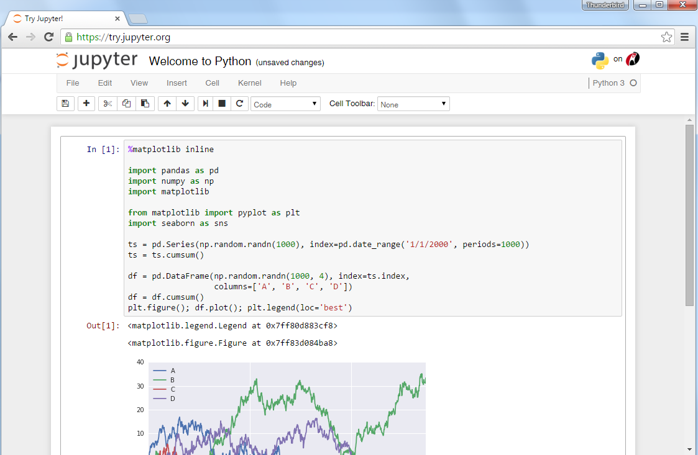
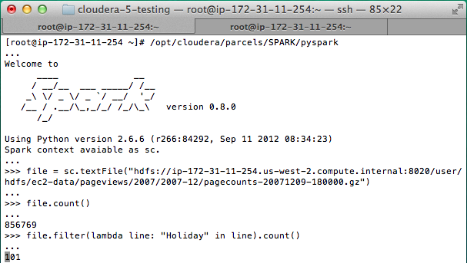
Interactive Shell
The Fastest Way to Learn Spark
Available in Python and Scala
Runs as an application on an existing Spark Cluster…
OR Can run locally
IPython notebook (Jupyter) is supported
Notes:
The barrier to entry for working with the spark API is minimal

Slide 36
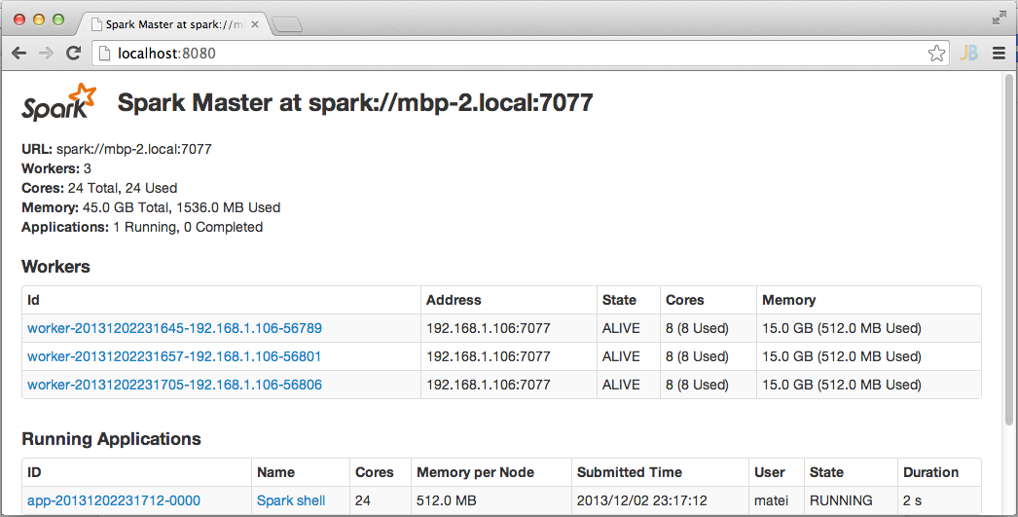
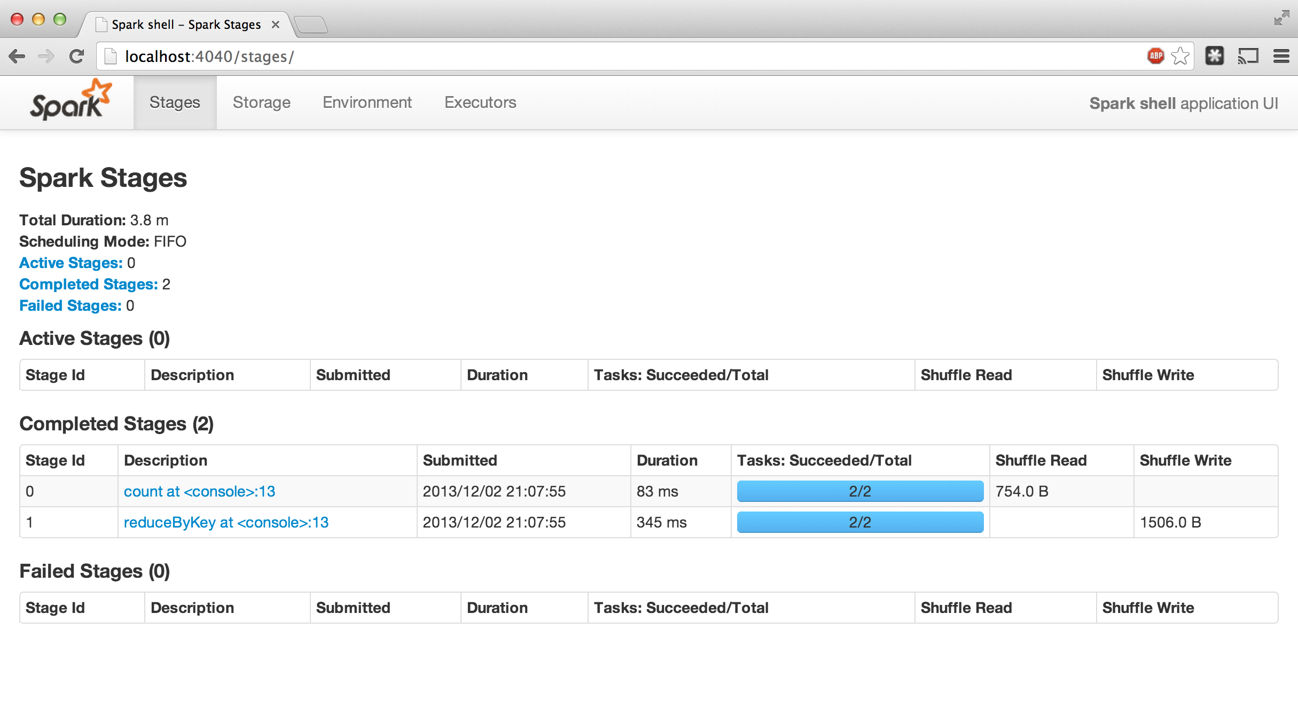
Administrative GUIs
http://<Standalone Master>:8080 (by default)

Slide 37
SparkContext
Main entry point to Spark functionality. A SparkContext represents the connection to a Spark cluster, and can be used to create RDD and broadcast variables on that cluster.
Available in shell as variable sc
In standalone programs, you’d make your own:
from pyspark import SparkContext
sc = SparkContext('local', 'App Name')
The first argument is mode:
‘local’: Run Spark locally with one worker thread (i.e. no parallelism at all).
‘local[K]’: Run Spark locally with K worker threads (ideally, set this to the number of cores on your machine: ‘local[*]’)
‘yarn-client’: The Spark driver runs in the client process, and the application master is only used for requesting resources from YARN.
‘yarn-cluster’: The Spark driver runs inside an application master process which is managed by YARN on the cluster
You need to set HADOOP_CONF_DIR: export HADOOP_CONF_DIR=/etc/hadoop/conf
Notes:
Meaning in the terminal server

Slide 38
Launching Spark with IPython Notebook
#IPYTHON_OPTS="notebook" /home/scollot/spark/bin/pyspark --master local[8] --jars "/home/scollot/spark/lib/spark-csv_2.11-1.2.0.jar,/home/scollot/spark/lib/commons-csv-1.2.jar“
#export PATH=/usr/lib64/qt-3.3/bin:/bin:/usr/bin:/usr/local/bin:/usr/local/sbin:/usr/sbin:/sbin:/export/home/scollot/bin:/export/home/scollot/bin:/BIGDATA/opt/iaa/anaconda2/bin
#export PYSPARK_PYTHON=/BIGDATA/opt/iaa/anaconda2/bin/python

Slide 39
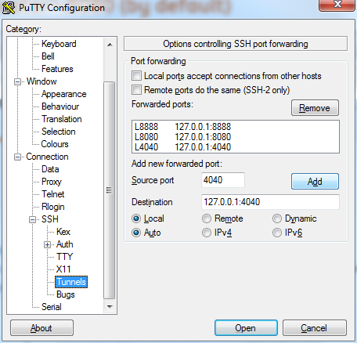
SSH port forwarding
Port to forward:
Your Ipython port (default 8888)
8080 and 4040 for Spark GUI in local mode

Slide 40
Creating RDDs
# Turn a Python collection into an RDD
sc.parallelize([1, 2, 3])
# Load text file from local FS, HDFS, or S3
sc.textFile(“file.txt”)
sc.textFile(“directory/*.txt”)
sc.textFile(“hdfs://namenode:9000/path/file”)

Slide 41
Basic Transformations
lambda == anonymous functions
nums = sc.parallelize([1, 2, 3])
# Pass each element through a function
squares = nums.map(lambda x: x*x) // {1, 4, 9}
# Keep elements passing a predicate
even = squares.filter(lambda x: x % 2 == 0) // {4}
# Map each element to zero or more others
nums.flatMap(lambda x: => range(x))
# => {0, 0, 1, 0, 1, 2}
Range object (sequence of numbers 0, 1, …, x-1)
Notes:
All lazy

Slide 42
Basic Actions
nums = sc.parallelize([1, 2, 3])
# Retrieve RDD contents as a local collection
nums.collect() # => [1, 2, 3]
# Return first K elements
nums.take(2) # => [1, 2]
# Count number of elements
nums.count() # => 3
# Merge elements with an associative function
nums.reduce(lambda x, y: x + y) # => 6
# Write elements to a text file
nums.saveAsTextFile(“hdfs://file.txt”)
Notes:
Launch computations

Slide 43
Some Key-Value Operations
pets = sc.parallelize([(“cat”, 1), (“dog”, 1), (“cat”, 2)])
pets.reduceByKey(lambda x, y: x + y) # => {(cat, 3), (dog, 1)}
pets.groupByKey() # => {(cat, [1, 2]), (dog, [1])}
pets.sortByKey() # => {(cat, 1), (cat, 2), (dog, 1)}
reduceByKey also automatically implements combiners on the map side

Slide 44
Example: Word Count
lines = sc.textFile(“hamlet.txt”)
counts = lines.flatMap(lambda line: line.split(“ ”)) .map(lambda word => (word, 1)) .reduceByKey(lambda x, y: x + y)
“to” “be” “or”
(to, 1) (be, 1) (or, 1)
(be, 2) (not, 1)
“to be or”
“not” “to” “be”
(not, 1) (to, 1) (be, 1)
(or, 1)
(to, 2)
“not to be”

Slide 45
Table Operators
Table (RDD) operators are inherited from Spark:
map
filter
groupBy
sort
union
join
leftOuterJoin
rightOuterJoin
reduce
count
fold
reduceByKey
groupByKey
cogroup
cross
zip
sample
take
first
partitionBy
mapWith
pipe
save
...

Slide 46
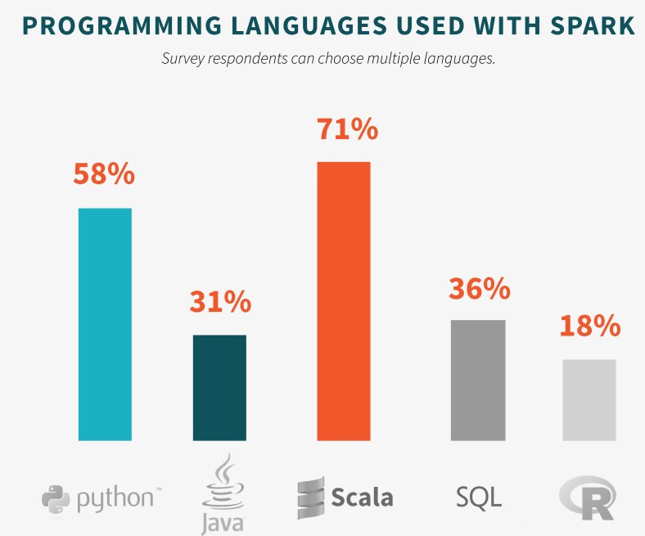
Spark Scala or Python?
Notes:
The barrier to entry for working with the spark API is minimal

Slide 47
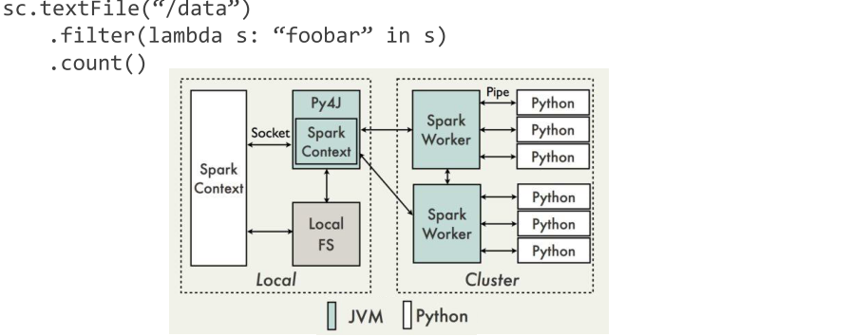
PySpark Architecture
Notes:
JVM = Java Virtual Machine

Slide 48
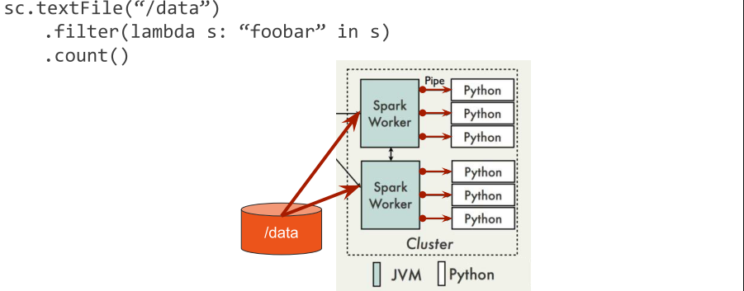
PySpark Architecture
Java-to-Python communication is expensive

Slide 49
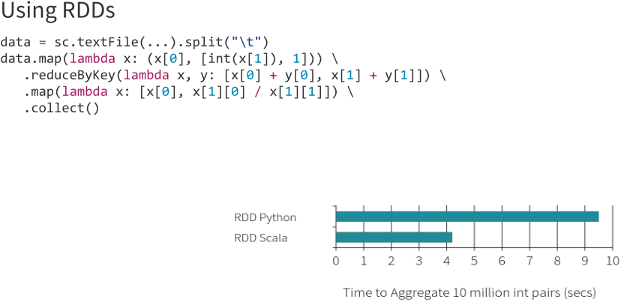
Moving beyond Python performance

Slide 50
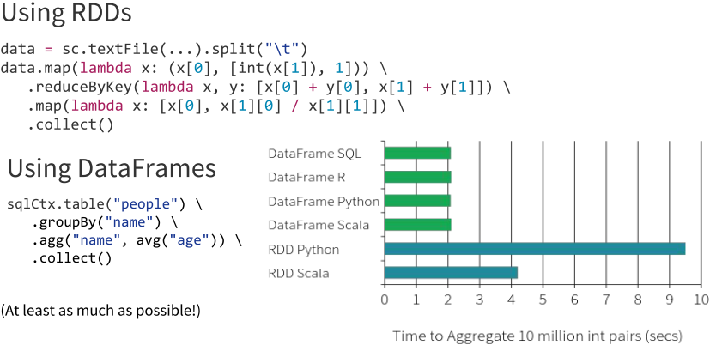
Moving beyond Python performance – DataFrames !

Slide 51
Spark DataFrame
Distributed collection of data organized into named columns
With RDD you don’t know any thing about the data
DataFrame is like an RDD but with metadata, there is a schema!
Recent!
Was called SchemaRDD before but was very slow and buggy
big improvements in Spark 1.5.0 released Sep 09, 2015
Better performances than RDD (as you saw in the previous slide)
Write less code and it is more readable (as you saw in the previous slide)
Optimized, for example it will load only the column you need: lazy
Notes:
The barrier to entry for working with the spark API is minimal

Slide 52
Spark SQL and Hive
Spark SQL also supports reading and writing data stored in Apache Hive.
The entry point is HiveContext:
from pyspark.sql import HiveContext
sqlContext = HiveContext(sc)
sqlContext.sql("CREATE TABLE IF NOT EXISTS src (key INT, value STRING)")
sqlContext.sql("LOAD DATA LOCAL INPATH 'examples/src/main/resources/kv1.txt' INTO TABLE src")
# Queries can be expressed in HiveQL.
results = sqlContext.sql("FROM src SELECT key, value").collect()
Notes:
The barrier to entry for working with the spark API is minimal

Slide 53

Parquet
Apache Parquet is a columnar storage format available to any project in the Hadoop ecosystem. It has 3 main purposes:
Interoperability
Space efficiency
Query efficiency
Spark can run SQL queries on parquet files (read and write):
df = sqlContext.load("people.parquet")
df.select("name", "age").save("namesAndAges.parquet")
Notes:
The barrier to entry for working with the spark API is minimal

Slide 54
Spark MLlib
Pipeline! DataFrame
Notes:
The barrier to entry for working with the spark API is minimal

Slide 55
A small python visualization on the data
Notes:
The barrier to entry for working with the spark API is minimal

Slide 56
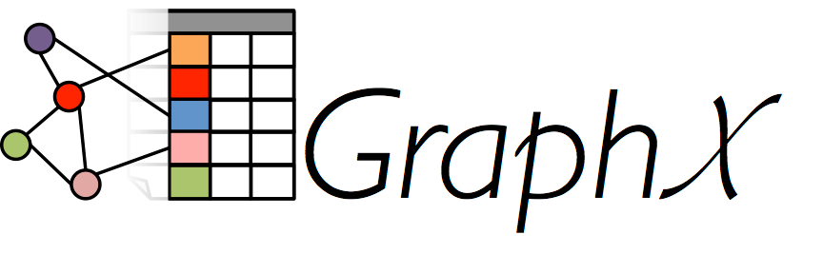
Introduction to Spark GraphX

Slide 57
Graphs are Central to Analytics
Hyperlinks
PageRank
Top 20 Pages
Raw
Wikipedia
Text
Table
Title
PR
< / >
Title
Body
Term-Doc
Graph
Topic Model
(LDA)
< / >
< / >
Word Topics
XML
Word
Topic
Discussion
Table
Community
Detection
User
Community
Community
Topic
Editor Graph
User
Disc.
User
Com.
Topic
Com.
Notes:
Wiki pedia data set > hyperlink graph > page rank
Topic modelling, map word to document,
Wikipedia as community > switch user are member of what cumminty
With topic discussed with community

Slide 58
PageRank: Identifying Leaders
Rank of user i
Weighted sum of neighbors’ ranks
Update ranks in parallel
Iterate until convergence
Notes:
What is PR, for a begin Vertex I
Iterate to convercence crieteria

Slide 59
The Graph-Parallel Pattern
Model / Alg.
State
Computation depends only on the neighbors
Notes:
Every vertex/edge, I don’t need to access the entire graph

Slide 60
Graphs are Central to Analytics
Hyperlinks
PageRank
Top 20 Pages
Raw
Wikipedia
Text
Table
Title
PR
< / >
Title
Body
Term-Doc
Graph
Topic Model
(LDA)
< / >
< / >
Word Topics
XML
Word
Topic
Discussion
Table
Community
Detection
User
Community
Community
Topic
Editor Graph
User
Disc.
User
Com.
Topic
Com.
Notes:
Graphs AND tables to analysis to store to combine

Slide 61



Separate Systems to Support Each View
Table View
Graph View
Pregel
Table
Dependency Graph
Row
Row
Result
Row
Row
Notes:
Traditionnaly the way that analytics will be done wil be with 2 systems, key value processing, Graph system
----- Meeting Notes (1/5/14 14:58) -----
Spark too.

Slide 62



Having separate systems for each view is difficult to use and inefficient
Difficult: Users must Learn, Deploy, and Manage multiple systems
Inefficient: Extensive data movement and duplication across the network and file system
< / >
XML
HDFS
HDFS
HDFS
HDFS

Slide 63


Solution: The GraphX Unified Approach
New API
Blurs the distinction between Tables and Graphs
New System
Combines Data-Parallel Graph-Parallel Systems
Enabling users to easily and efficiently express the entire graph analytics pipeline
Notes:
Easy to switch between these view

Slide 64
Tables and Graphs are composable views of the same physical data
GraphX Unified
Representation
Table View
Graph View
Each view has its own operators that exploit the semantics of the view
to achieve efficient execution
Notes:
and users can move between views without copying or moving data

Slide 65
View a Graph as a Table
Vertex Property Table
Property Graph
Id
Rxin
Jegonzal
Franklin
Istoica
Property (V)
(Stu., Berk.)
(PstDoc, Berk.)
(Prof., Berk)
(Prof., Berk)
R
F
Edge Property Table
Src Id | Dst Id
rxin | jegonzal
franklin | rxin
istoica | franklin
franklin | jegonzal
Property (E)
Friend
Advisor
Coworker
PI
J
I

Slide 66
Graph Operators
class Graph [ V, E ] {
def Graph(vertices: Table[ (Id, V) ],
edges: Table[ (Id, Id, E) ])
// Table Views -----------------
def vertices: Table[ (Id, V) ]
def edges: Table[ (Id, Id, E) ]
def triplets: Table [ ((Id, V), (Id, V), E) ]
// Transformations ------------------------------
def reverse: Graph[V, E]
def subgraph(pV: (Id, V) => Boolean,
pE: Edge[V,E] => Boolean): Graph[V,E]
def mapV(m: (Id, V) => T ): Graph[T,E]
def mapE(m: Edge[V,E] => T ): Graph[V,T]
// Joins ----------------------------------------
def joinV(tbl: Table [(Id, T)]): Graph[(V, T), E ]
def joinE(tbl: Table [(Id, Id, T)]): Graph[V, (E, T)]
// Computation ----------------------------------
def mapReduceTriplets(mapF: (Edge[V,E]) => List[(Id, T)], reduceF: (T, T) => T): Graph[T, E]
}
def aggregateMessages(sendMsg: (Edge[V,E]) => T, mergeMsg: (T, T) => T): Graph[T, E]
Notes:
3 way to see as a tab;e
Operation on the graph
Join graph with table
mrTriplet: compute ability
Graph transformation, reverse, subgraph, transform property, add external data by joining
Make mrTriplets more visible.

Slide 67
Triplets Join Vertices and Edges
The triplets operator joins vertices and edges:
Vertices
Triplets
Edges
A
A
A
A
B
B
B
B
A
C
A
C
C
B
C
B
C
D
C
D
C
D
The mrTriplets operator sums adjacent triplets.
SELECT t.dstId, reduceUDF( mapUDF(t) ) AS sum
FROM triplets AS t GROUPBY t.dstId
Notes:
I do 2 joins: start with my Edges and join with Properties once to get the source property and a second by the destination property
Unified data: group by
w

Slide 68
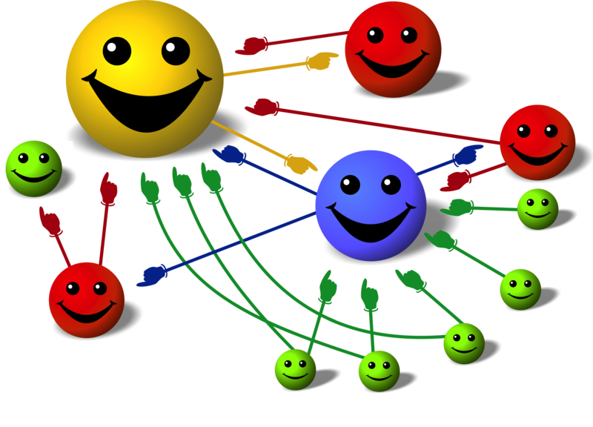
Key concept
“Think like a Vertex”
Notes:
Think as Vertex, aggregate

Slide 69
Map Reduce Triplets, Aggregate Neighbors
Map-Reduce for each vertex
B
C
mapF( )
A₁
A
B
A
mapF( )
A₂
A
C
D
E
reduceF( , )
A
A₁
A₂
F
Notes:
Map function is executed on each edge in fact in parallel
Example, my triplet map -> B-A and C-A reduce this two to modify the vertex property
mapF == sendMsg
reduceF == mergeMsg

Slide 70
Example: Oldest Follower
23
42
B
C
What is the age of the oldest follower for each user?
val oldestFollowerAge = graph .mapReduceTriplets( trip=> (trip.dst.id, trip.src.age),//Map (a,b)=> max(a, b) //Reduce ) .vertices
val oldestFollowerAge = graph .aggregateMessages( trip=> trip.sendToDst(trip.src.age),//Map (a,b)=> max(a, b) //Reduce ) .vertices
30
A
D
19
E
75
F
16

Slide 71
Pregel and GraphLab abstractions using the GraphX operators in less than 50 lines of code!
By composing these operators we can construct entire graph-analytics pipelines.

Slide 72

Project: Prediction heart failure using ensemble learning

Slide 73
Objective
General objective:
Given medical records of a patient over a given time period, predict whether he is likely to develop Heart Failure within a certain period of time
Methodology:
Use training set as well as machine learning tools to train a classifier
Notes:
10 years is long enough

Slide 74
Dataset
We are using data set. Time period of 10 years from 2005 to 2015.
Some numbers about the dataset:
772.189 laboratory results
313.921 diagnostics
120.953 prescription medications
269.301 vital signs
10.460 patients
including 4.712 patients diagnosed with Diseases Of The Circulatory System
ICD9 code within [390.0; 495.0]
including 879 patients diagnosed with Congestive heart failure
ICD9 code 428.0
Notes:
10 years is long enough

Slide 75

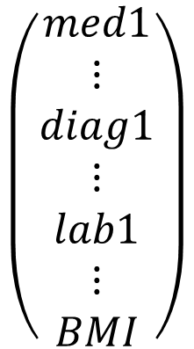
Feature construction
Features taken into account: medications, diagnostics, lab results and Body Mass Index (BMI)
The number of features need to be the same for every patient
60 diff. medications + 52 diff. diagnostics + 100 diff. lab results + 1 BMI
= 213-dimensional features vector
$$\left(\begin{matrix}med1 \\ ⋮ \\ diag1 \\ ⋮ \\ lab1 \\ ⋮ \\ BMI\end{matrix}\right)$$
Notes:
10 years is long enough

Slide 76
Cohort construction
Features
Diagnostic of HF
Labeled “YES”
(presence of HF diagnostic)
Observation window
Prediction window
= 1 year
Features
No diagnostic of HF
Labeled “NO”
(absence of HF diagnostic)
Observation window
Notes:
We ASSUME THAT THERE ARE NO DIAGNOSTIC OR HF before the recording of the data.
Prediction window

Slide 77
Training set construction
Only 5% of patients with HF in dataset
95% accuracy if the classifier always output “NO”
This is NOT what we are trying to achieve
Much more interesting to have a low false negative rate – helps prevent risk
Solution: Stratified Sampling
50% of patients with heart failure and 50% without in our training dataset

Slide 78
Classifiers
Binary classification: each patient is either a “YES” or a “NO”
Base classifiers:
Logistic regression
Decision trees
Unstable classifiers: use of ensemble learning to decrease variance and improve accuracy
Bagging for logistic regression
Random forest for decision trees

Slide 79
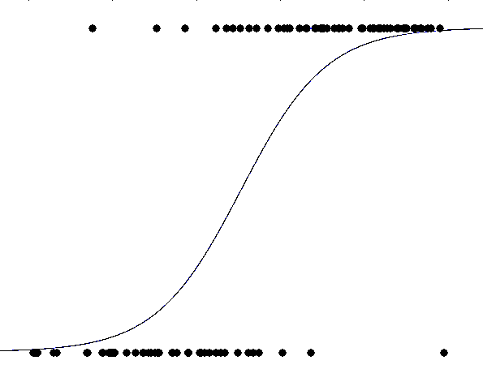
Logistic Regression - Bagging
Training dataset 1
Classifier
Model 1
Training dataset 2
Classifier
Model 2
Logistic Regression
Data
.
.
.
.
.
.
.
.
.
.
.
.
Averaged
Model
Stratified Resampling w/ replacement
Voting
Training dataset m-1
Classifier
Model m-1
Training dataset m
Classifier
Model m

Slide 80
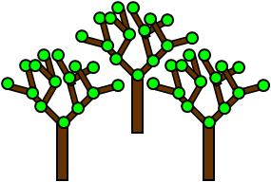
Decision Trees - Random Forest
Main idea
Generation of a large number of decision trees introducing some randomness in the construction of the tree
For each split in a tree, variables are chosen at random
Combination of the results output by the different trees to calculate the final result
Use of vote for final classification
Random Forest
Notes:
TO BE REMOVED ? Or merge with up

Slide 81



Methods – Technology Stack
We are using
Spark v1.3.0 (released Mar 13, 2015)
Spark MLlib
Spark ML (high-level API for machine learning pipelines)
Scala
Amazon Web Service
GitHub
Notes:
Spark v1.3.0 released 2 weeks ago, Cutting edge technologie

Slide 82

Cross Validation
K-fold cross validation for validating performance
K = 10 folds for cross validation
Cross validation can also be used to determine optimum number of models in the bag
B = 10, 20, 30
Cross validation results used to pick out the classifier with best parameters overall
Notes:
Do we use the “determine optimum number of models in the bag” ??? If yes what is the answer?
Piprline

Slide 83
ML Pipeline
ML Pipeline makes experimentation easy with Parameter Grid
Integrated two new algorithms with ML pipeline:
class BaggedLogisticRegression
class RandomForestforPipeline
Regularizer | Bag size | …
1.0 | 10 | .
0.1 | 20 | .
0.01 | 30 | .
. | . | .
Strategy | Feature Subset | …
Classification | auto | .
Regression | sqrt | .
. | . | .
Notes:
Do we use the “determine optimum number of models in the bag” ??? If yes what is the answer?
Piprline

Slide 84
Results – Confusion Matrices
Logistic Regression - Bagging
96% accuracy
Decision trees - Random Forest
98% accuracy
 |  | Prediction
 |  | 0 Healthy | 1 Case Patient
Actual | 0 Healthy | True negative 73 | False positive 3
 | 1 Case Patient | False negative 3 | True positive 83
 |  | Prediction
 |  | 0 Healthy | 1 Case Patient
Actual | 0 Healthy | True negative 74 | False positive 2
 | 1 Case Patient | False negative 0 | True positive 86
Notes:
Number of bags = number of trees = 10
Testing set != training set
False negative as Yannick explained

Slide 85
Thank you

